Slide 1






Endogenous population and the social cost of carbon
Richard S.J. Tol
University of Sussex
Vrije Universiteit, Amsterdam
Tinbergen Institute
CESifo
Payne Institute

Slide 2
Social cost of carbon
The social cost of carbon is the damage done by emitting one additional tonne of carbon dioxide
If evaluated along the optimal emissions trajectory, it is the Pigou-Bator tax that internalizes the externality and restores efficiency
The social cost of carbon is estimated with integrated assessment models that capture the cause-effect chain from emissions to impacts
Integrated assessment models typically take population growth as given – it is not
Demo-economic models are complicated and welfare is hard if population is endogenous

Slide 3
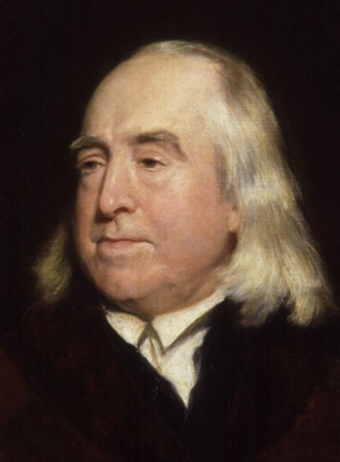
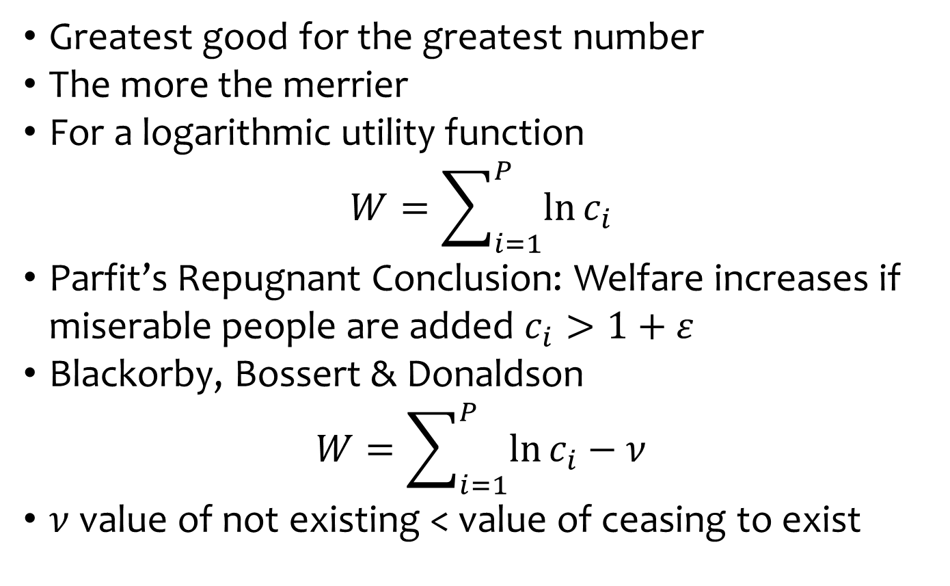
Welfare functions
Greatest good for the greatest number
The more the merrier
For a logarithmic utility function
$$W=\sum_{i=1}^{P}{\ln{c_{i}}}$$
Parfit’s Repugnant Conclusion: Welfare increases if miserable people are added $c_{i}>1+ε$
Blackorby, Bossert & Donaldson
$$W=\sum_{i=1}^{P}{\ln{c_{i}}}−ν$$
$ν$ value of not existing < value of ceasing to exist

Slide 4

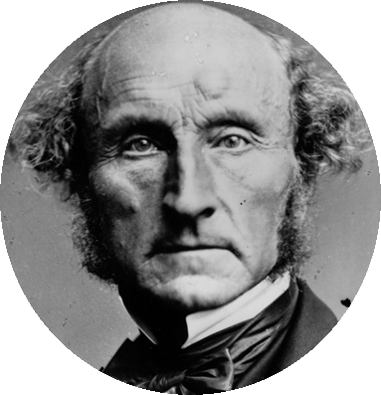
John Stuart Mill and Harriet Taylor Mill (1857)
If the earth must lose that great portion of its pleasantness which it owes to things that the unlimited increases of wealth and population would extirpate from it, for the mere purpose of enabling it to support a larger, but not a happier or better population, I sincerely hope, for the sake of posterity, that they will be content to be stationary long before necessity compels them to it.

Slide 5



Mills
There should be enough people to form fulfilling relationships, but not more
Extraordinary people are extraordinary

Slide 6
Mills
There should be enough people to form fulfilling relationships, but not more
Extraordinary people are extraordinary
Economies of scale, innovation (in production function)
Repugnant conclusion: If getting rid of below-average people were painless, we should do so
No one left when applied repeatedly

Slide 7
How does this relate to climate change?
If climate change reduces economic growth (Nordhaus 1992; Fankhauser and Tol 2005; Burke et al. 2015) and so increases the fertility rate, this is bad according to Mill and (probably) good according to Bentham
Climate change directly affects mortality
Infant mortality affects fertility
Climate change affects migration

Slide 8
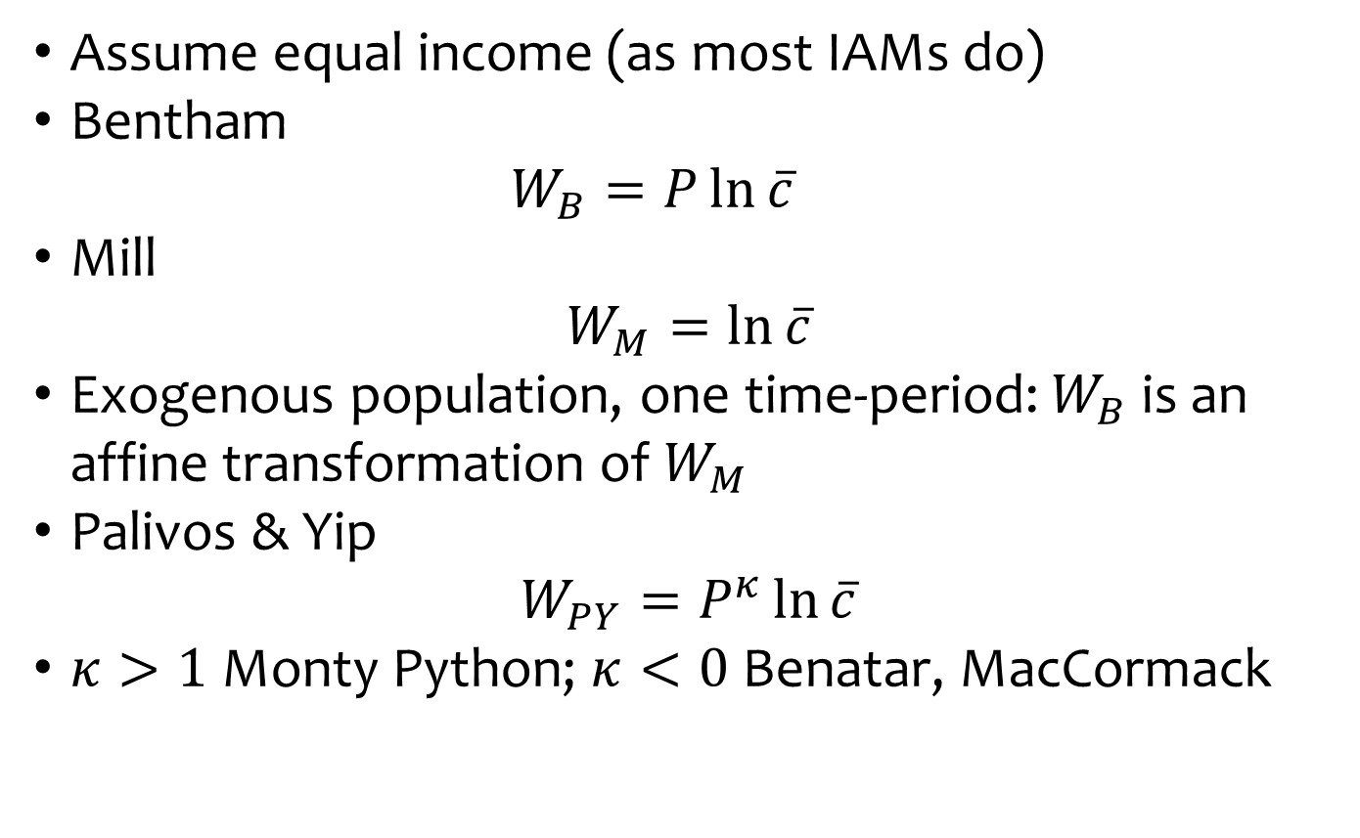
Welfare functions
Assume equal income (as most IAMs do)
Bentham
  $$W_{B}=P\ln{\overline{c}}$$
Mill
$$W_{M}=\ln{\overline{c}}$$
Exogenous population, one time-period: $W_{B}$ is an affine transformation of $W_{M}$
Palivos & Yip
$$W_{PY}=P^{κ}\ln{\overline{c}}$$
$κ>1$ Monty Python; $κ<0$ Benatar, MacCormack

Slide 9
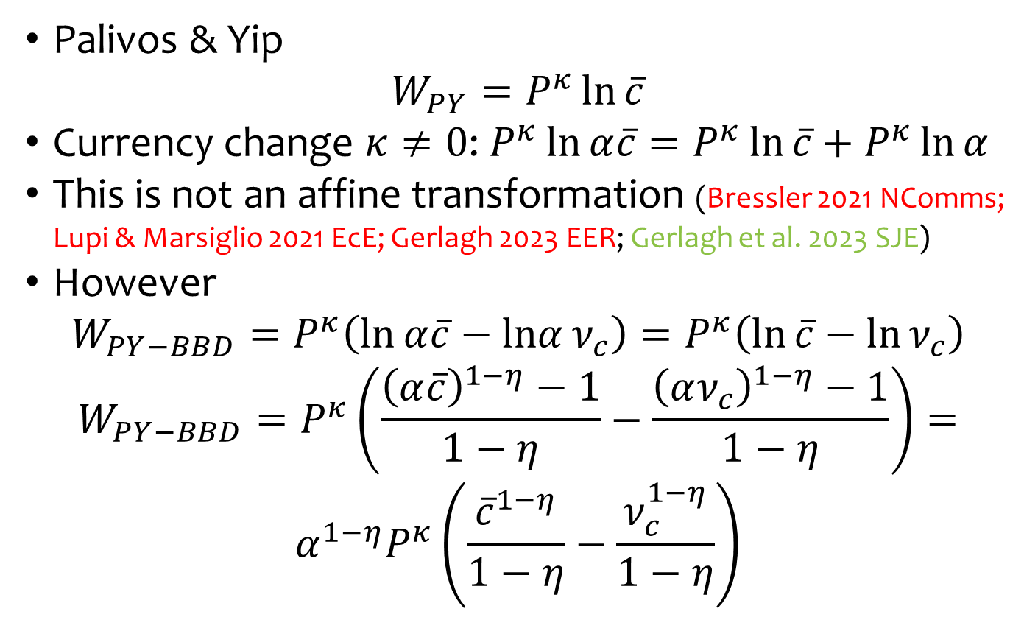
Homotheticity
Palivos & Yip
$$W_{PY}=P^{κ}\ln{\overline{c}}$$
Currency change $κ≠0$: $P^{κ}\ln{α\overline{c}}=P^{κ}\ln{\overline{c}}+P^{κ}\ln{α}$
This is not an affine transformation (Bressler 2021 NComms; Lupi & Marsiglio 2021 EcE; Gerlagh 2023 EER; Gerlagh et al. 2023 SJE)
However
$$W_{PY−BBD}=P^{κ}\left(\ln{α\overline{c}}−lnα{ν_{c}}\right)=P^{κ}\left(\ln{\overline{c}}−\ln{ν_{c}}\right)$$
$$W_{PY−BBD}=P^{κ}\left(\frac{{\left(α\overline{c}\right)}^{1−η}−1}{1−η}−\frac{{\left(αν_{c}\right)}^{1−η}−1}{1−η}\right)=$$
$$α^{1−η}P^{κ}\left(\frac{{\overline{c}}^{1−η}}{1−η}−\frac{ν_{c}^{1−η}}{1−η}\right)$$

Slide 10
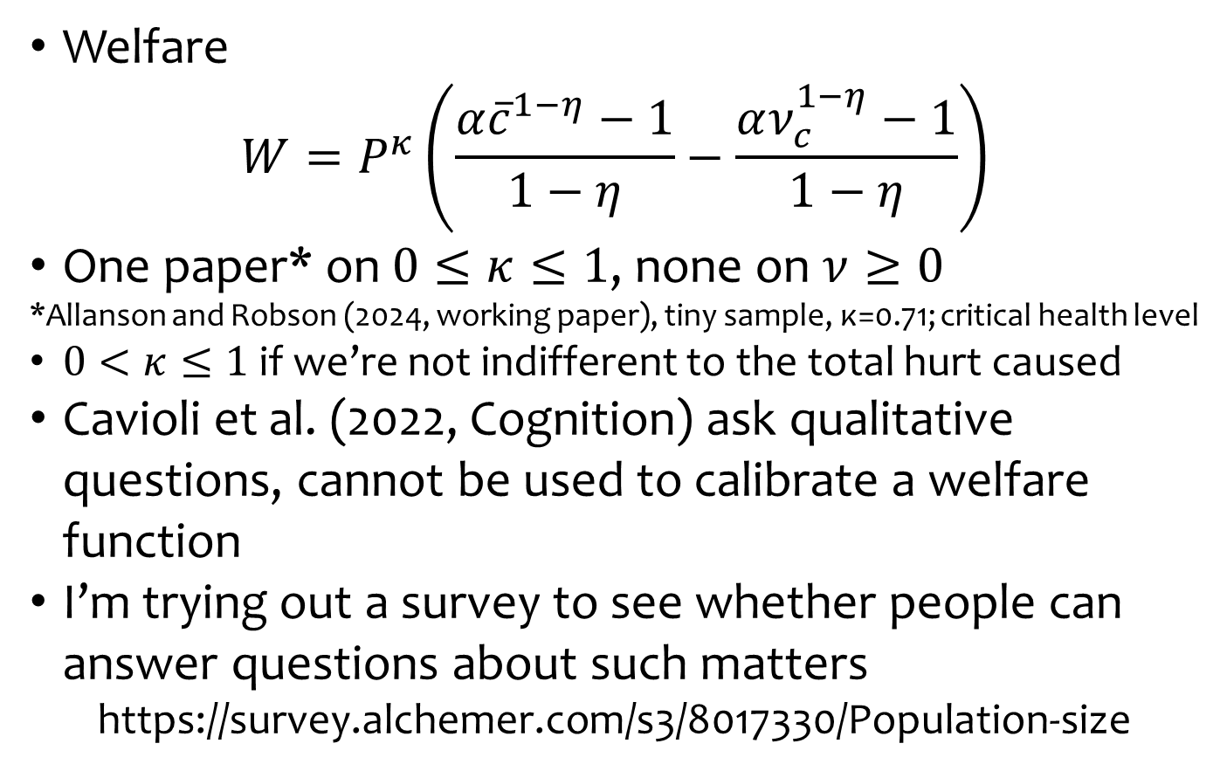
Welfare parameters
Welfare
$$W=P^{κ}\left(\frac{{α\overline{c}}^{1−η}−1}{1−η}−\frac{αν_{c}^{1−η}−1}{1−η}\right)$$
One paper* on $0≤κ≤1$, none on $ν≥0$
*Allanson and Robson (2024, working paper), tiny sample, κ=0.71; critical health level
$0<κ≤1$ if we’re not indifferent to the total hurt caused
Cavioli et al. (2022, Cognition) ask qualitative questions, cannot be used to calibrate a welfare function
I’m trying out a survey to see whether people can answer questions about such matters
https://survey.alchemer.com/s3/8017330/Population-size

Slide 11
Choice between fewer
people all above income
threshold and more
people implies nu.
Median ~$11,000/p/y
(Brazil does not make the cut,
but Malaysia does)
I’ll use $2/d/p (World Bank) and $25/p/d (the median a few weeks ago)

Slide 12
Choice between fewer,
richer and more, poorer
people implies kappa.

Slide 13
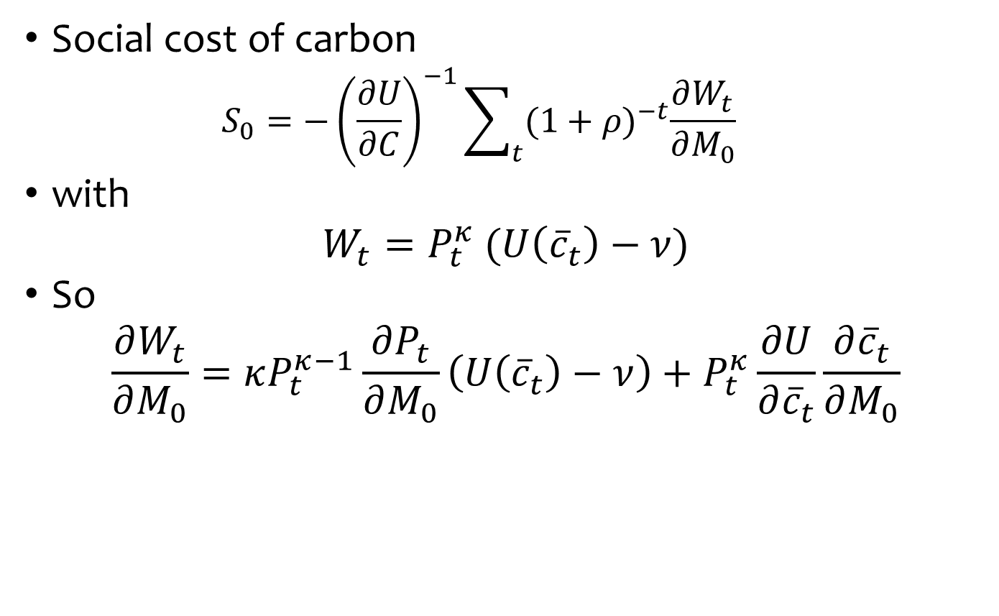
Social cost of carbon
Social cost of carbon
  $$S_{0}=−{\left(\frac{∂U}{∂C}\right)}^{−1}\sum_{t}{{(1+ρ)}^{−t}\frac{∂W_{t}}{∂M_{0}}}$$
with
$$W_{t}=P_{t}^{κ} (U\left({\overline{c}}_{t}\right)−ν)$$
So
$$\frac{∂W_{t}}{∂M_{0}}=κP_{t}^{κ−1}\frac{∂P_{t}}{∂M_{0}}\left(U\left({\overline{c}}_{t}\right)−ν\right)+P_{t}^{κ}\frac{∂U}{∂{\overline{c}}_{t}}\frac{∂{\overline{c}}_{t}}{∂M_{0}}$$

Slide 14
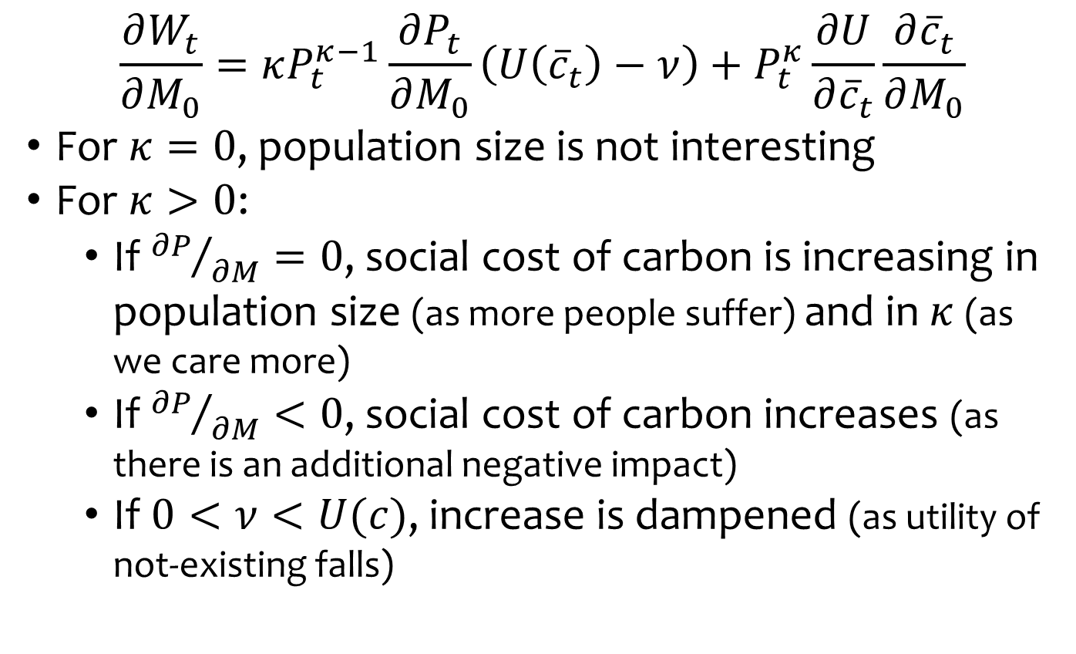
Marginal impact of carbon
$$\frac{∂W_{t}}{∂M_{0}}=κP_{t}^{κ−1}\frac{∂P_{t}}{∂M_{0}}\left(U\left({\overline{c}}_{t}\right)−ν\right)+P_{t}^{κ}\frac{∂U}{∂{\overline{c}}_{t}}\frac{∂{\overline{c}}_{t}}{∂M_{0}}$$
For $κ=0$, population size is not interesting
For $κ>0$:
  If ${∂P}/{∂M}=0$, social cost of carbon is increasing in population size (as more people suffer) and in $κ$ (as we care more)
  If ${∂P}/{∂M}<0$, social cost of carbon increases (as there is an additional negative impact)
  If $0<ν<U(c)$, increase is dampened (as utility of not-existing falls)

Slide 15
Integrated Assessment Model
Carbon cycle: Maier-Reimer – Hasselmann
Climate: Schneider – Thomson
Growth: Solow – Swan
Energy use, emissions: Nordhaus
Impacts: Nordhaus – Schelling
Non-standard:
  Climate change impacts on mortality: Bressler
    Mortality increases by 0.96%/K
  Impact of economic growth on fertility and mortality: This paper
    Change in population growth: -0.012 ln(Y/P)

Slide 16
PRTP = 1%; EMUC = 1; SSP2; I = -1.4%; e = -0.36

Slide 17

Interpretation
Social cost of carbon increases in $κ$ which determines how it scales with population
Critical level utility is irrelevant if population is exogenous

Slide 18
PRTP = 1%; EMUC = 1; SSP2; I = -1.4%; e = -0.36

Slide 19
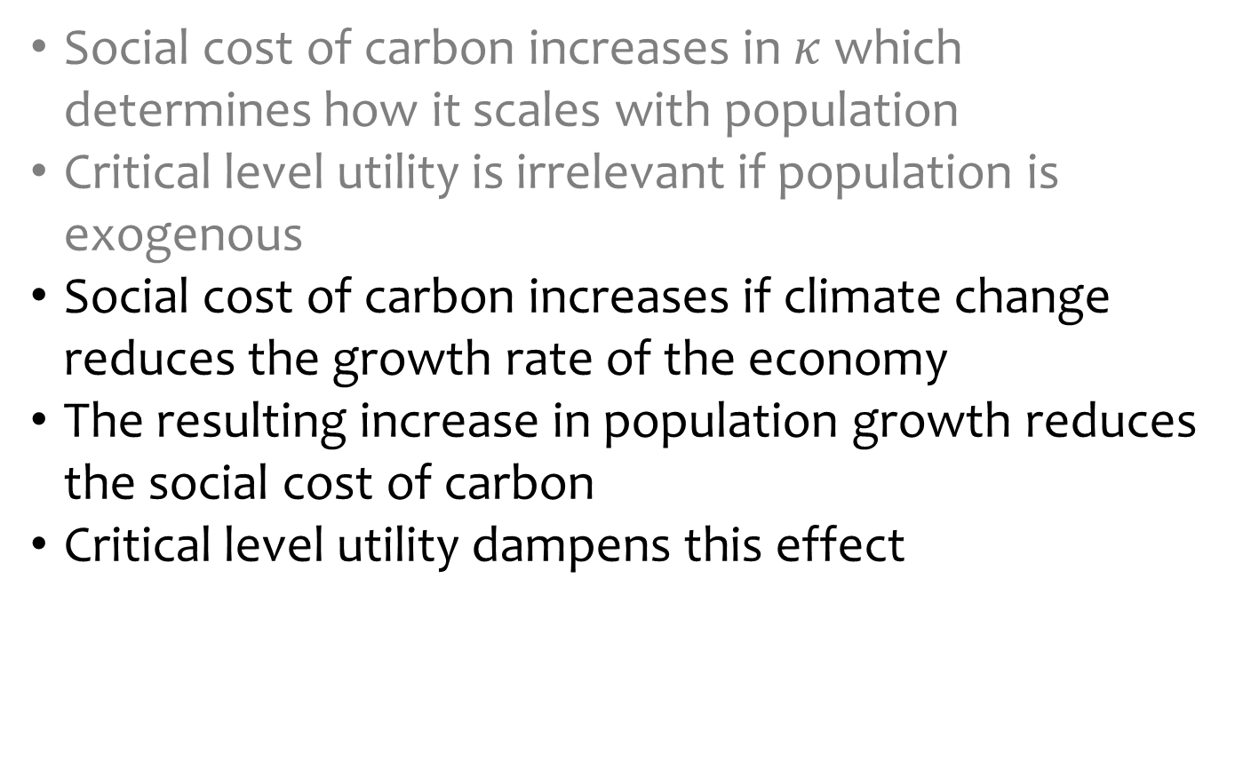
Interpretation
Social cost of carbon increases in $κ$ which determines how it scales with population
Critical level utility is irrelevant if population is exogenous
Social cost of carbon increases if climate change reduces the growth rate of the economy
The resulting increase in population growth reduces the social cost of carbon
Critical level utility dampens this effect

Slide 20
Bressler (2021)
PRTP = 1%; EMUC = 1; SSP2; I = -1.4%; e = -0.36

Slide 21
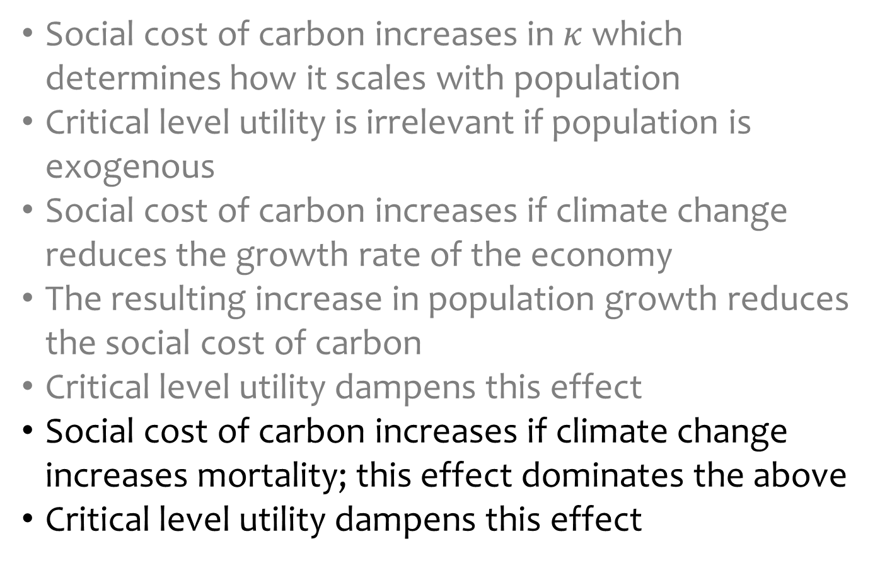
Interpretation
Social cost of carbon increases in $κ$ which determines how it scales with population
Critical level utility is irrelevant if population is exogenous
Social cost of carbon increases if climate change reduces the growth rate of the economy
The resulting increase in population growth reduces the social cost of carbon
Critical level utility dampens this effect
Social cost of carbon increases if climate change increases mortality; this effect dominates the above
Critical level utility dampens this effect

Slide 22
In a Solow-Swan model, higher mortality means more capital per worker means richer people means reduced vulnerability to climate change.

Slide 23

Parameters
The Ramsey rule with population
$$r=ρ+ηg_{y}−κg_{p}$$
If we keep the social discount rate (or interest rate) as is, then the pure rate of time preference (say) is increasing in the population elasticity of welfare

Slide 25
Conclusion
The social cost of carbon is very sensitive to endogenous population growth

Slide 26
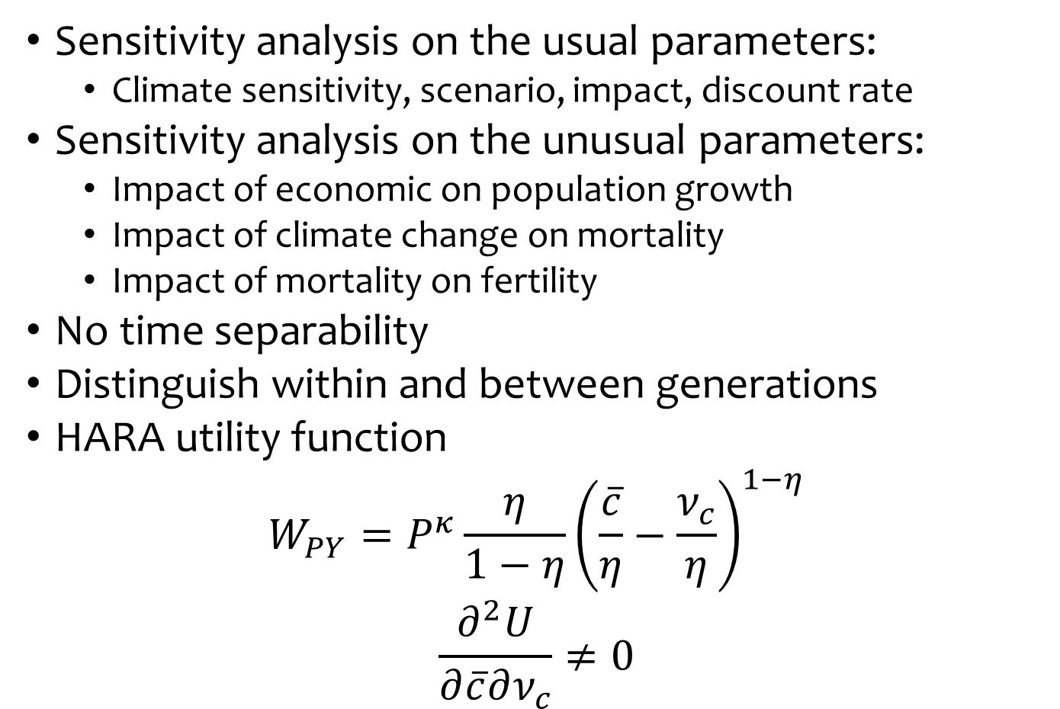
To be done
Sensitivity analysis on the usual parameters:
  Climate sensitivity, scenario, impact, discount rate
Sensitivity analysis on the unusual parameters:
  Impact of economic on population growth
  Impact of climate change on mortality
  Impact of mortality on fertility
No time separability
Distinguish within and between generations
HARA utility function
$$W_{PY}=P^{κ}\frac{η}{1−η}{\left(\frac{\overline{c}}{η}−\frac{ν_{c}}{η}\right)}^{1−η}$$
$$\frac{∂^{2}U}{∂\overline{c}∂ν_{c}}≠0$$

Slide 27
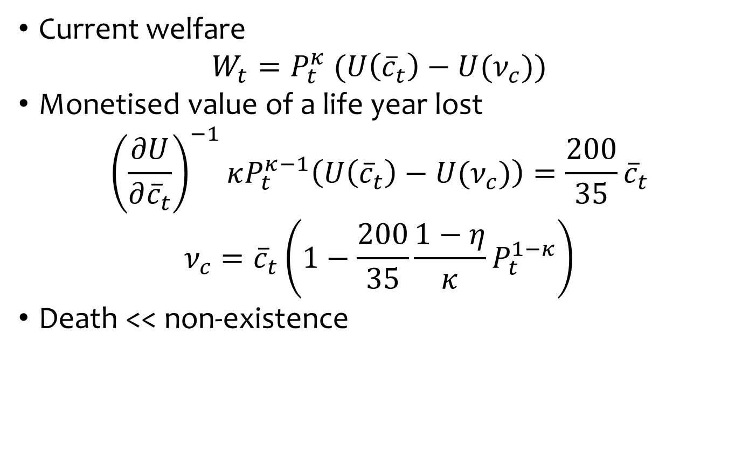
Death v non-existence
Current welfare
$$W_{t}=P_{t}^{κ} (U\left({\overline{c}}_{t}\right)−U(ν_{c}))$$
Monetised value of a life year lost
$${\left(\frac{∂U}{∂{\overline{c}}_{t}}\right)}^{−1}κP_{t}^{κ−1}\left(U\left({\overline{c}}_{t}\right)−U(ν_{c})\right)=\frac{200}{35}{\overline{c}}_{t}$$
$$ν_{c}={\overline{c}}_{t}\left(1−\frac{200}{35}\frac{1−η}{κ}P_{t}^{1−κ}\right)$$
Death << non-existence

